Slide 1
INVESTIGATING HUMANITARIAN AND CONFLICT ISSUES/EXTRA-JUDICIAL KILLINGS
The people’s story

Slide 2
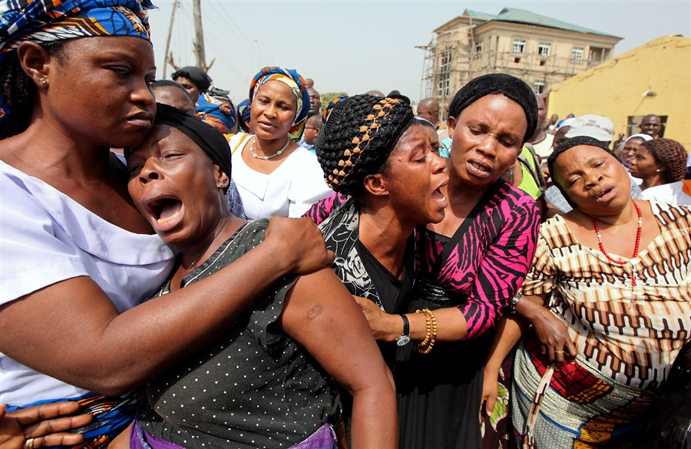
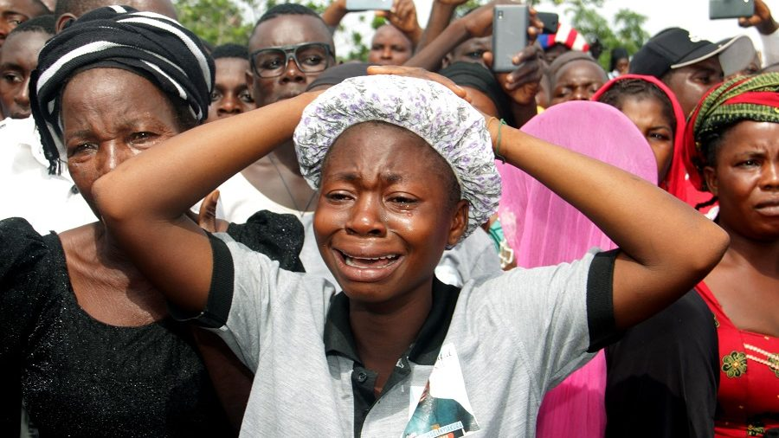
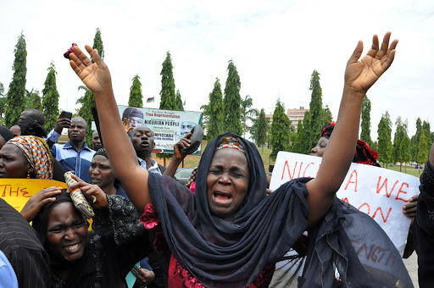
When we talk of conflicts, most times it seems far, until it hits home and we begin to hear the cries, the frustrations, the pain and the helplessness

Slide 3
Woman Praying Against Attackers

Slide 4
Man Talking Of How They Don’t Sleep At Night

Slide 5
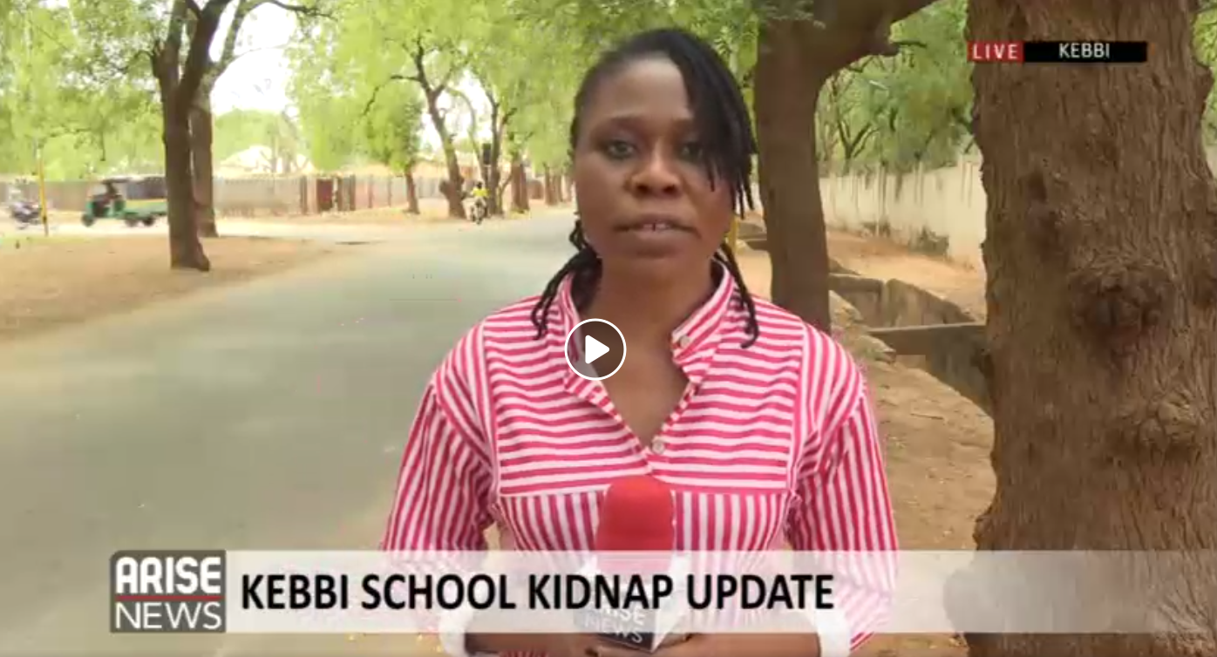
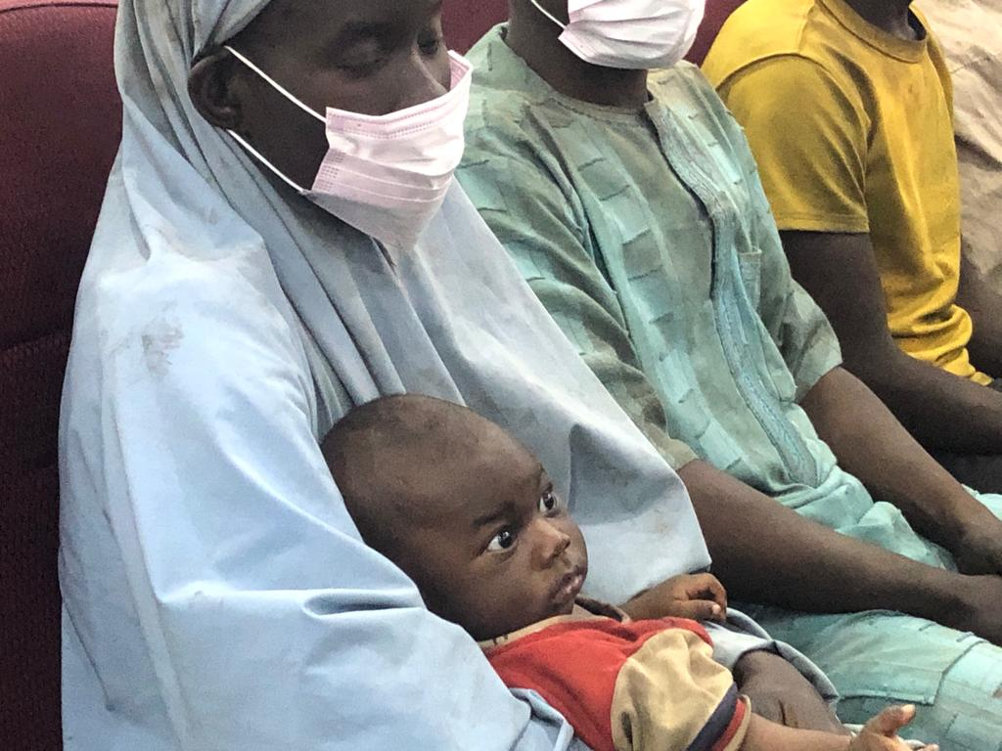
In 2020 December, I started covering more conflicts and crisis, particularly abductions

Slide 7
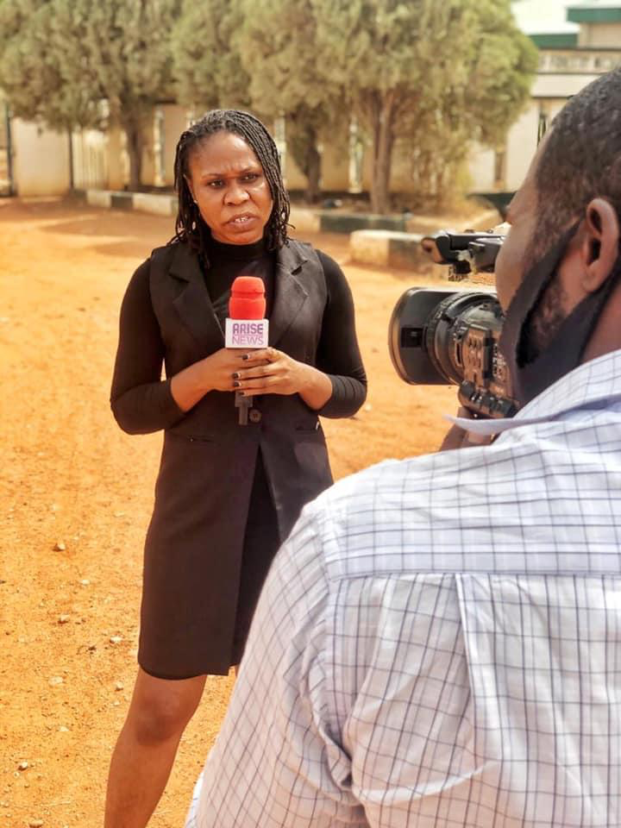
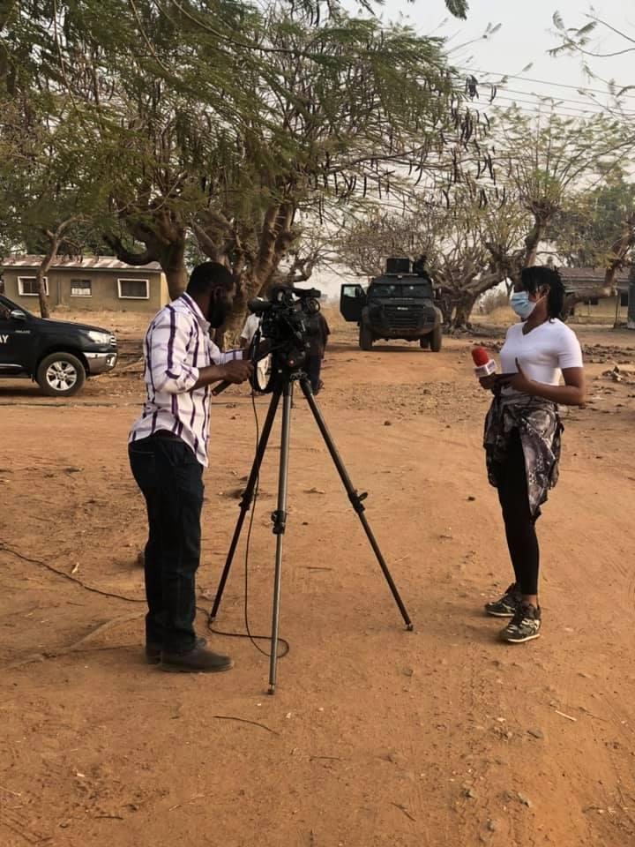
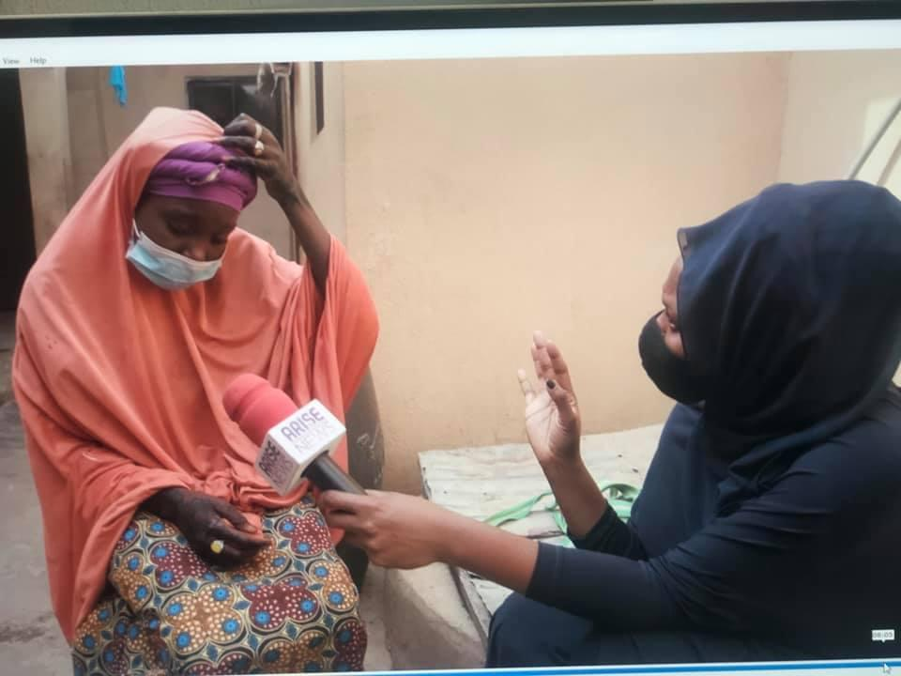
And in my ten months of this coverage, I have travelled to all of the states where these conflict situations have happened-Kankara in Katsina State, Kagara, in Niger State, Jangebe in Zamfara, Chibok, Afaka in Kaduna, Birnin Yauri in Kebbi state and Tegina again in Niger state. This is the order in which they have occurred from December of 2020 till date.

Slide 8
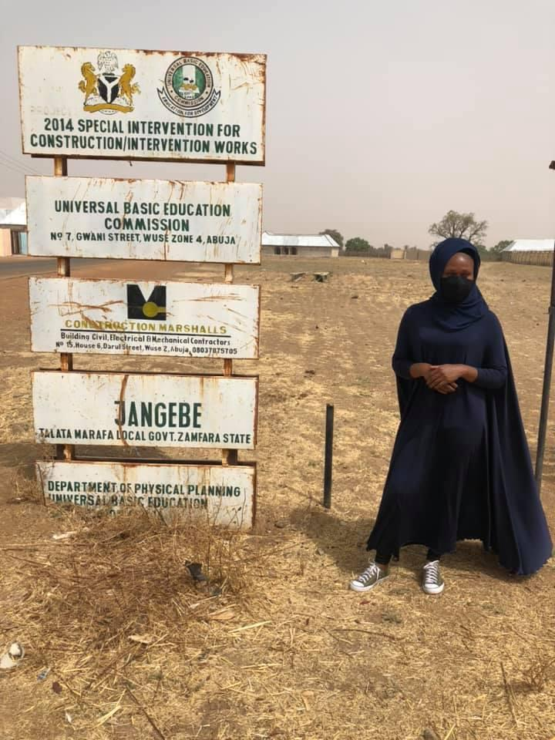
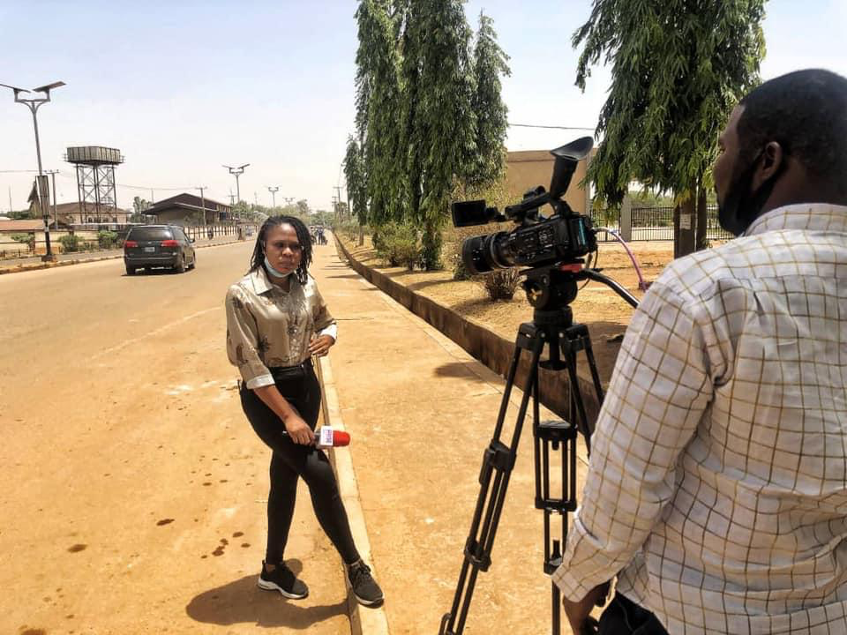
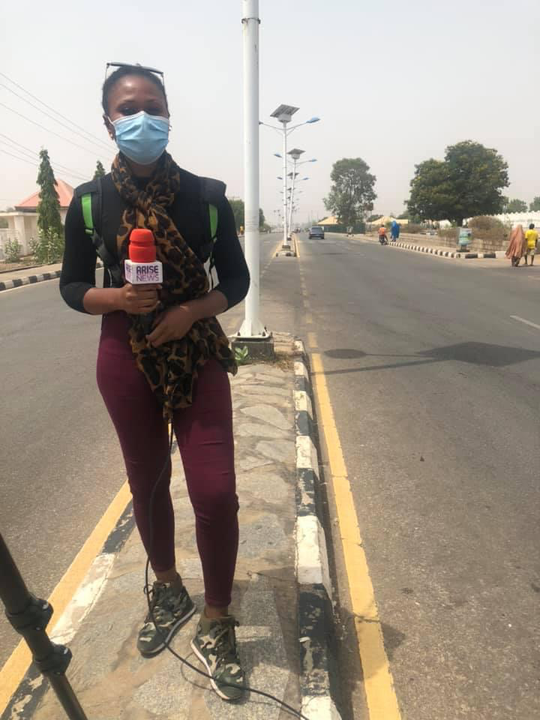
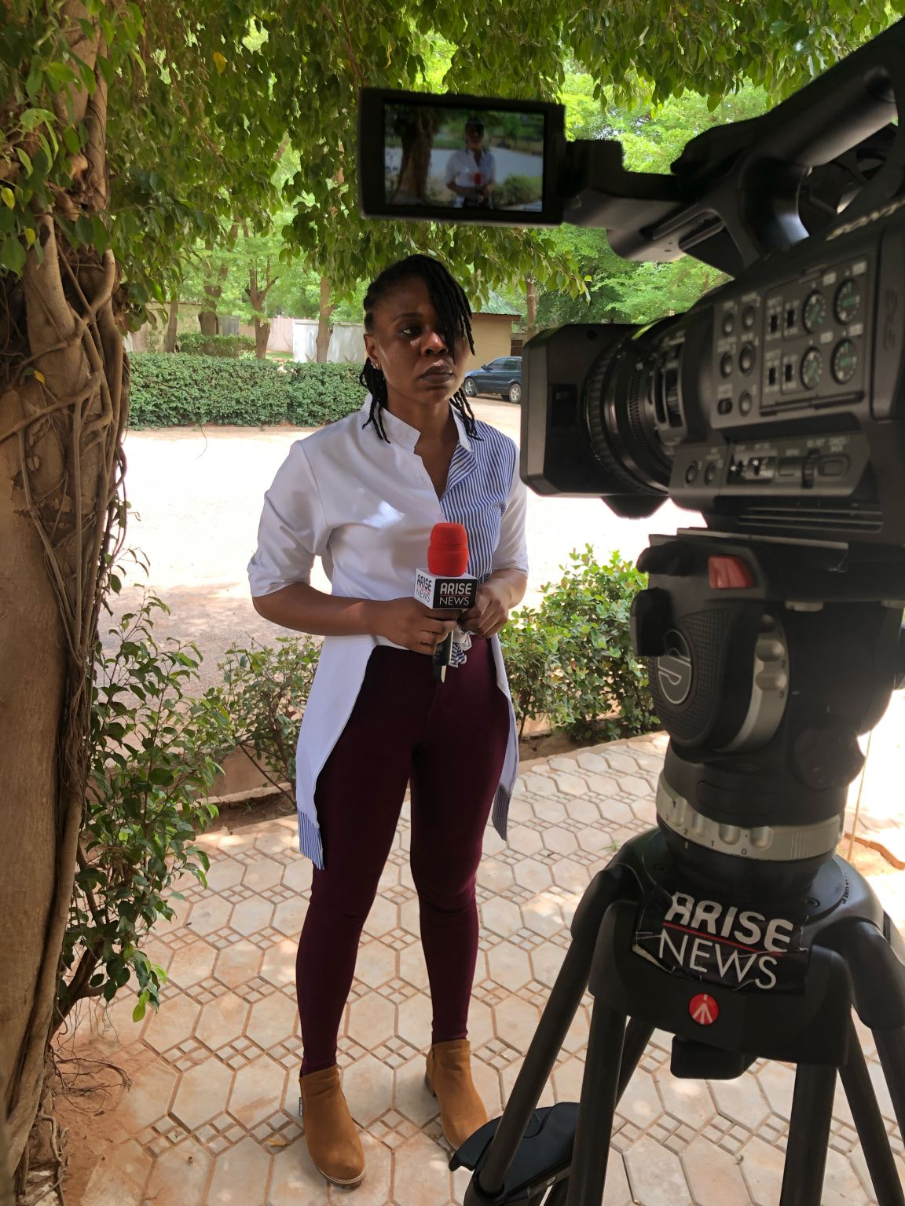

Slide 9
In all of this, human beings are the most affected. And sadly, these human beings have been reduced to figures and statistics. (Recall Chibok Encounter)

Slide 10
Since we are talking about figures, let’s see how women, men and children have now become refugees and displaced persons in their country, increasing the humanitarian crisis already on ground

Slide 11
Data from United Nations High Commission for Refugees (UNHCR) says Nigerians fleeing their homes due to conflict and violence is at a record high and now represents over one percent of Nigeria’s population.
As of April 30, 2021, at least 2.9 million Nigerian citizens have been sent out of their homes in the last eight years, which represent about 1.50 percent of Nigeria’s over 200 million population.

Slide 12
Out of this number, UNHCR also revealed that no fewer than 305,329 of these displaced Nigerians are living as refugees in Cameroun, Chad, and Niger.
Nigeria not only ranks fourth in the total number of IDPs to country’s population in Africa, it also accounts for 9.2 percent of Africa’s 29 million displacement crisis.

Slide 13
Displacement tops the list but so is trauma and sexual abuse- Refer to Governor Zulum’s comment at the just ended LCBC Governor’s forum on increased prostitution in the camps, sexual abuse etc
Babagana Zulum
Governor of Borno State

Slide 14
Education Over 1000 schools have been shut

Slide 15
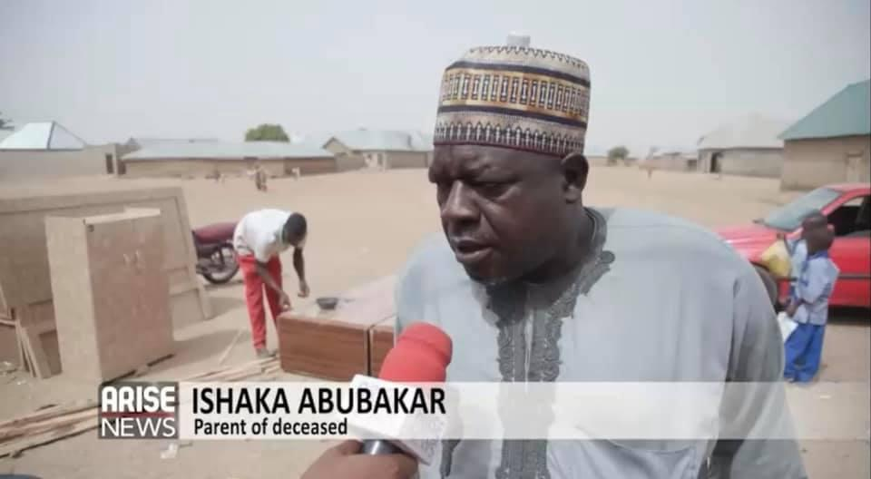
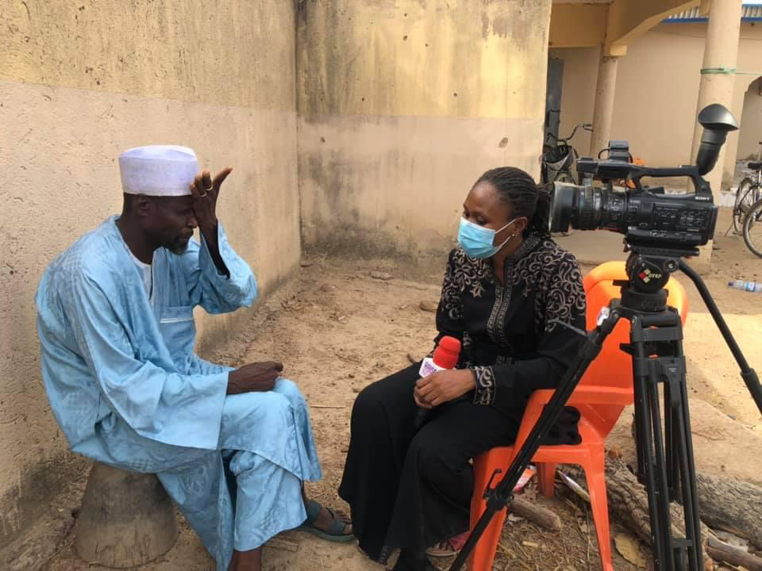
The number of deaths cannot well be established because we sadly do not have data. But for every one of these places I have covered, there has been records of death either of victims dying in captivity, or security personnel shot in the premises as well as some victims, or relatives dying from shock or trauma.

Slide 16
Why is anyone not Reporting these?

Slide 17
The right question is, is anyone reporting?

Slide 18
The answer is Yes, but not enough of it comes to light why?
Accessibility
Volatile Terrain
Capital Intensive

Slide 19
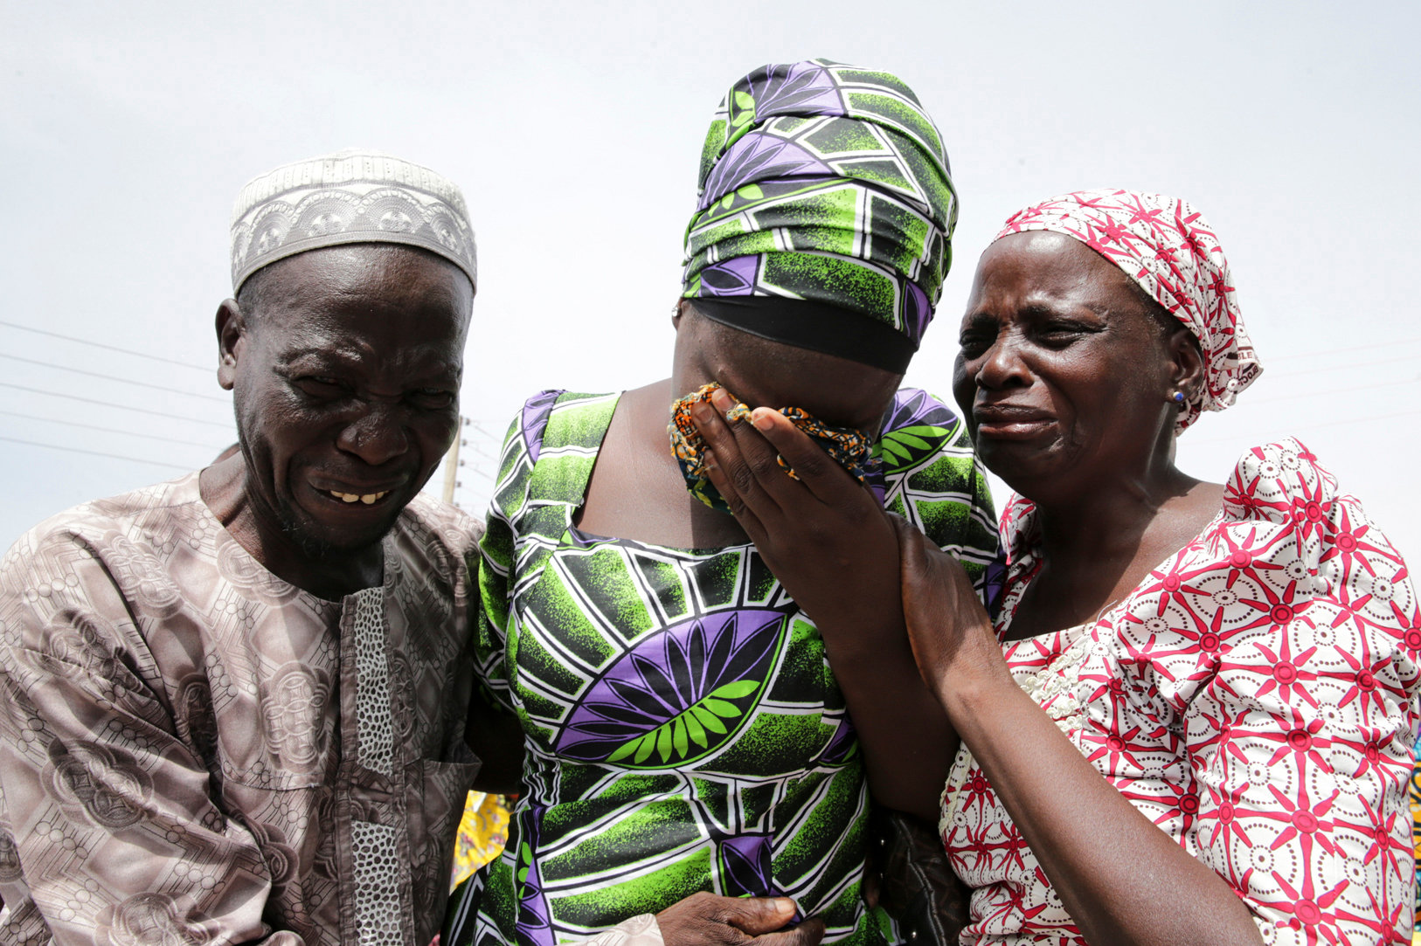
The answer is Yes, but not enough of it comes to light why?
Lastly, the seeming numbness of those affected to speak and even ‘the normalization of the abnormal and reducing each attack to press releases and reeling out of figures and statistics

Slide 20
What must we do?
Give this conflict a face
Name the people
Frantic efforts to stop all forms of violent extremism
Give the people a voice and mean to do so

